Slide 1
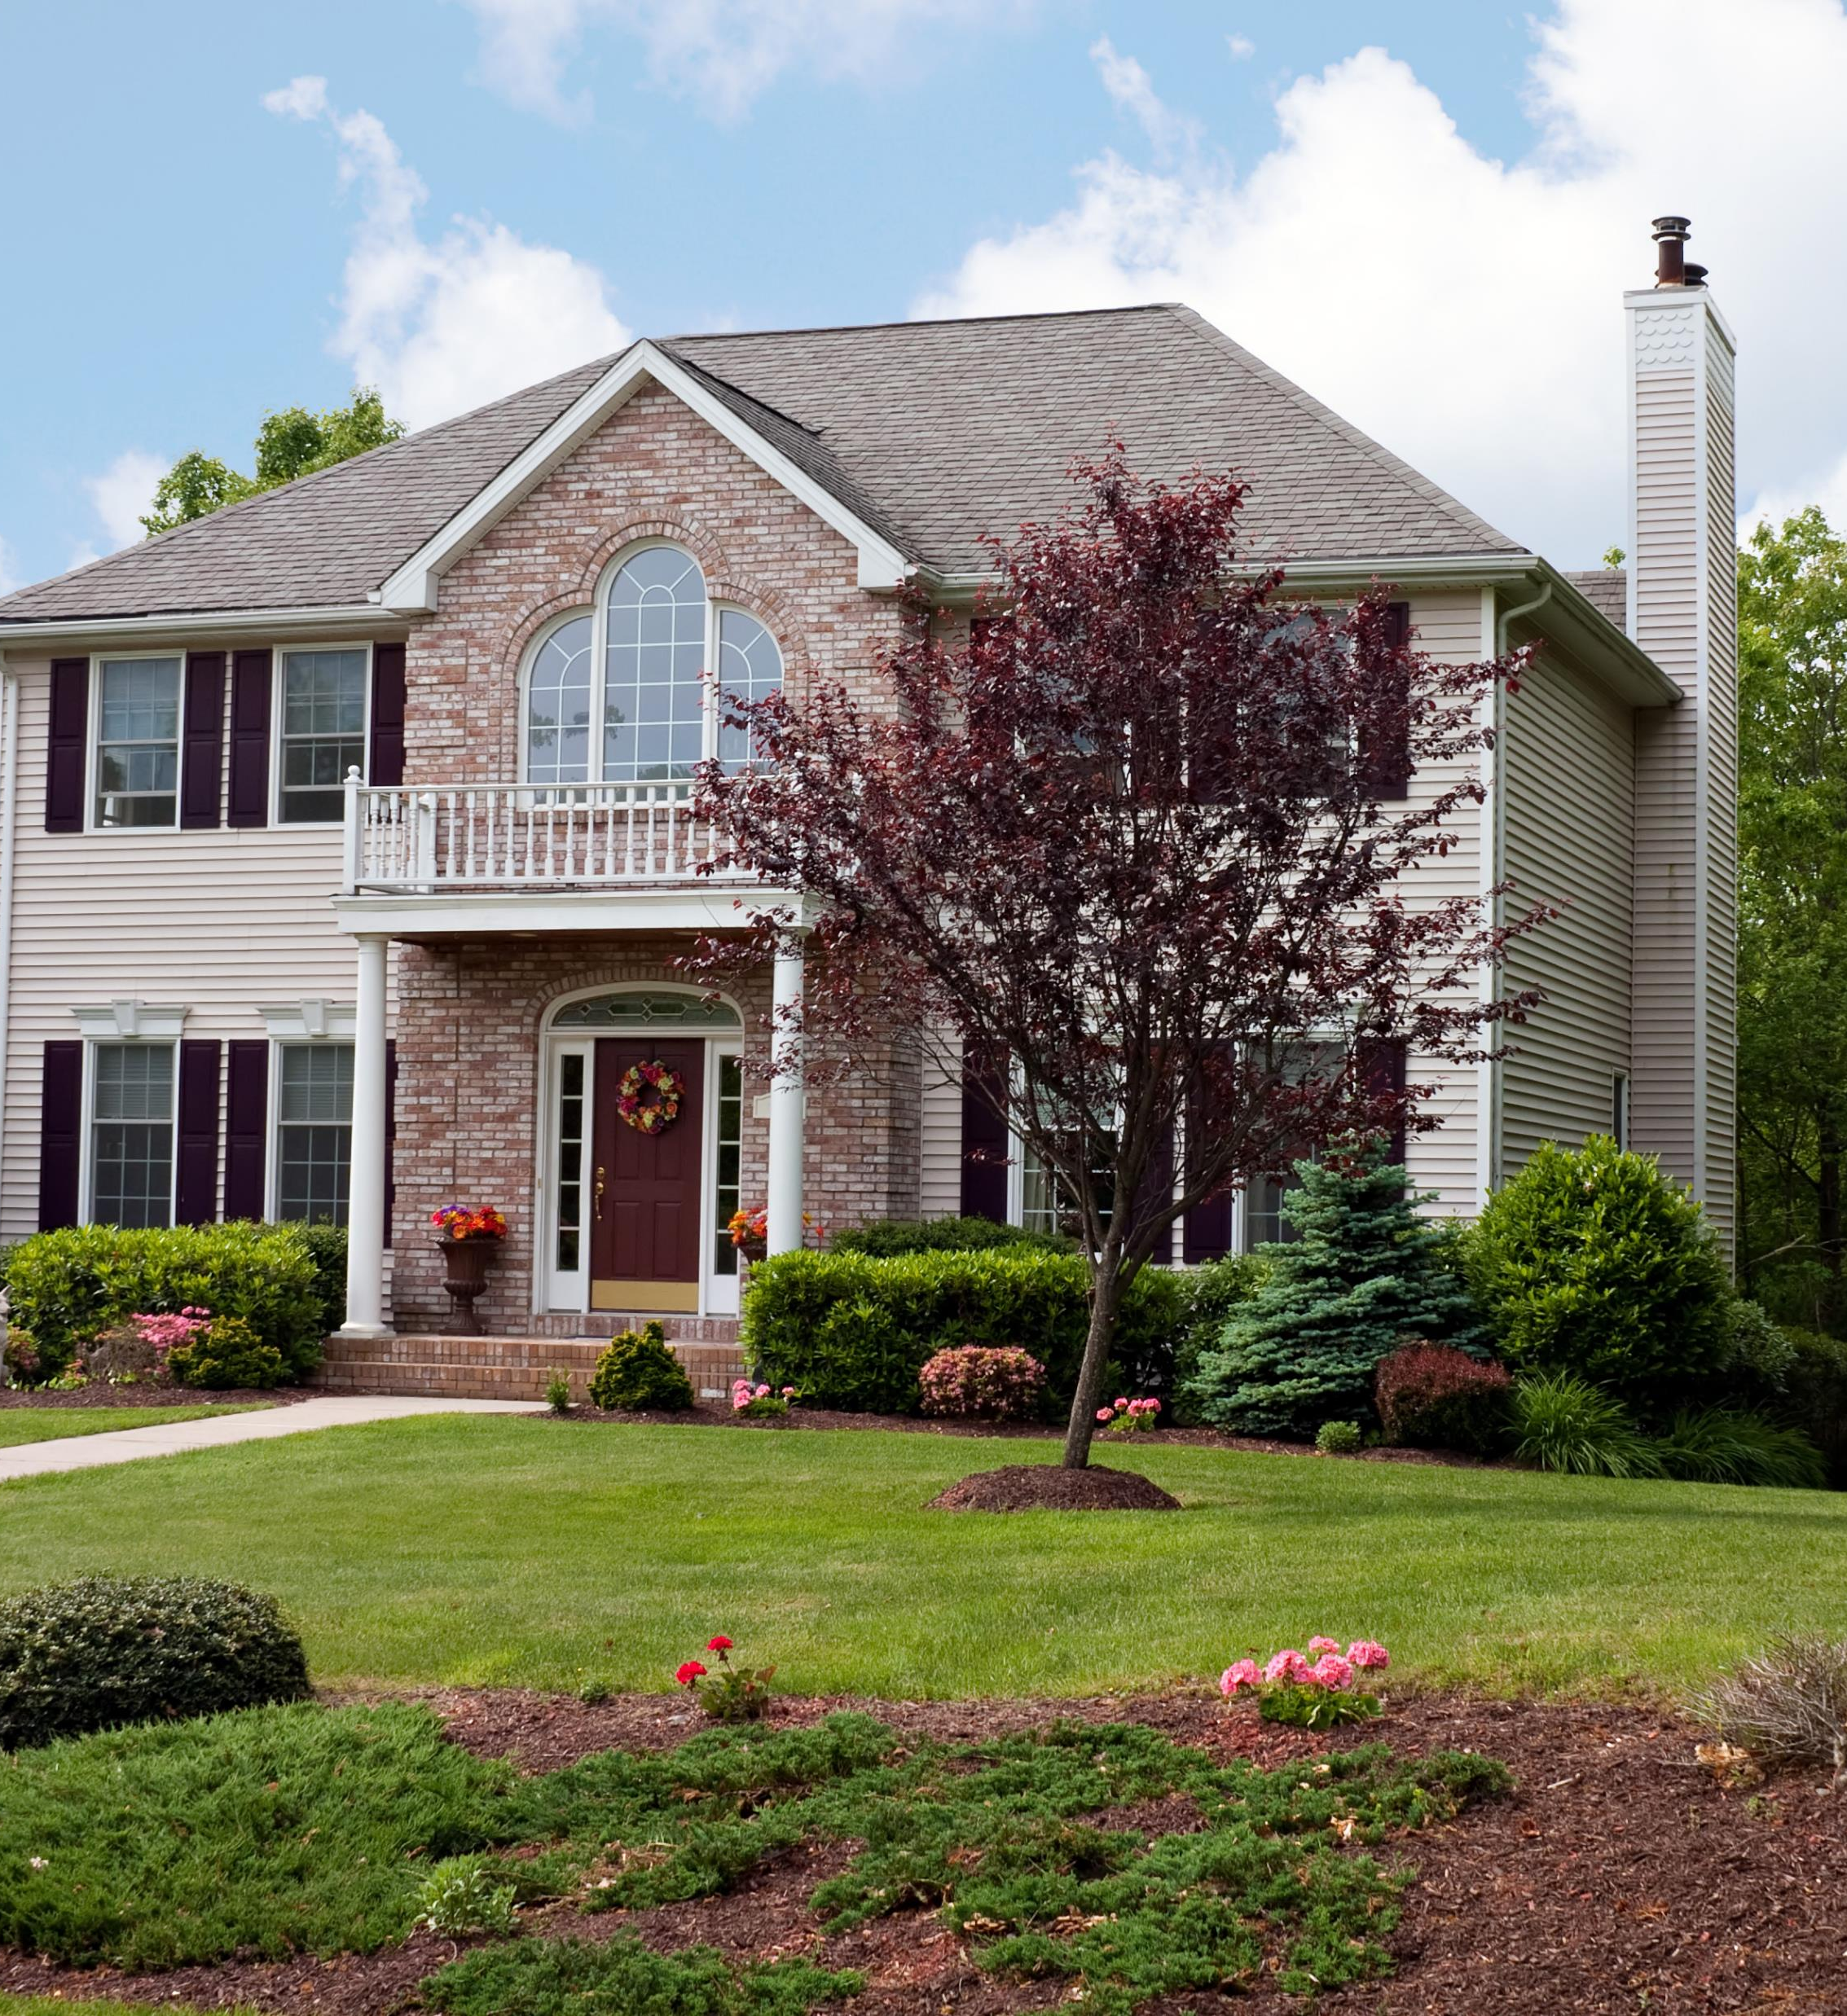
Texas Real Estate predict house prices based on various real estate features using Machine Learning Presented by: Rebecca, Natalie, Russell, Michael
Group 3 Project 2
Aug 11, 2024

Slide 2

Executive Summary
This project aims to develop a machine learning model to predict house prices based on various real estate features. The dataset contains essential information about houses, such as the number of bedrooms and bathrooms, lot size (in acres), house size (in square feet), and geographic location (city, state, and zip code). Additionally, key variables include the previous sale date, the house's age since the last sale, and the average house value in the corresponding zip code area. This project will provide valuable insights into real estate pricing, enabling stakeholders to make informed, data-driven decisions based on housing trends across different geographical regions.
Project Approach
Data Preprocessing: Prepare and clean the data, including handling missing values, encoding categorical variables (city, state, zip code), and scaling numerical features.
Model Development: Train machine learning models on the dataset to predict house prices (either as price per square foot or total house price). Potential models include CatboostRegression and DecisionTree Classifier.
Model Evaluation: Use a variety of metrics such as Mean Absolute Error (MAE), Mean Squared Error (MSE), and R-squared (R²) to evaluate model performance and refine it for accuracy.
Feature Importance: Identify the most important factors affecting house prices, such as location, house size, or lot size, and provide insights into market trends.
Predictive Analysis: Once a final model is selected, use it to make predictions on unseen data to assess its robustness in a real-world scenario.

Slide 3
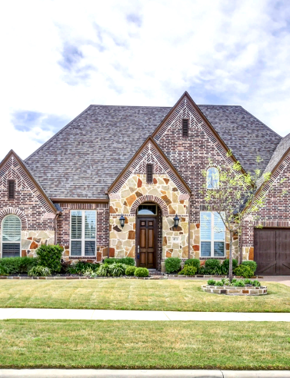
Dataset
USA Real Estate Dataset features real estate listing across the United States, categorized by State and Zip code. The original dataset, sourced from Kaggle, contained 2.2 million entries. We narrowed down the data by focusing exclusively on properties in Texas, resulting in a reduced dataset with 12 columns and 40,111 rows.
Data Exploration and Cleaning
In the data exploration phase, we thoroughly examined the dataset to understand its structure, variable types, and key statistics. We utilized visualizations to identify patterns, relationships, and outliers in the data.
For data cleaning, we addressed missing values, removed duplicates, and ensured correct data types for each column. We also dropped the columns we don’t need for data analysis. The cleaned dataset was then validated and prepared for further analysis or modeling.

Slide 4
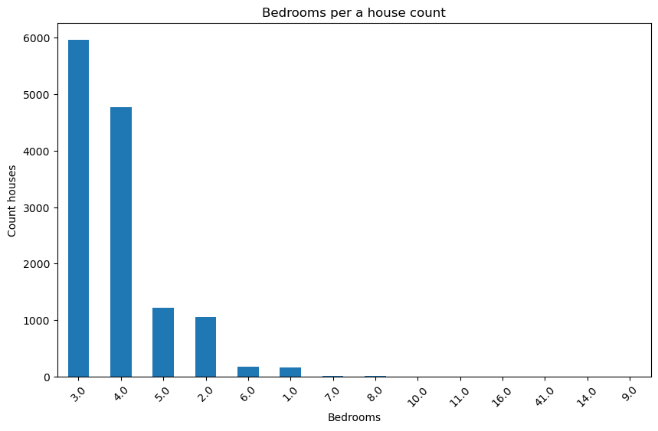
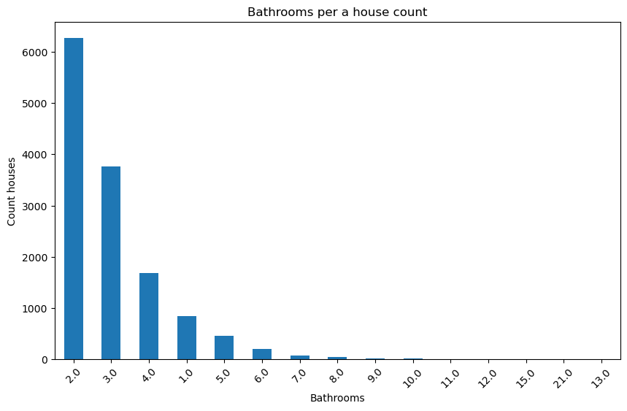
Dataset Visualization Pre-Model
Majority of our Dataset consisted of 3-4 beds and 2-3 bath houses. Here we can get glimpse of the average house in Texas.

Slide 5
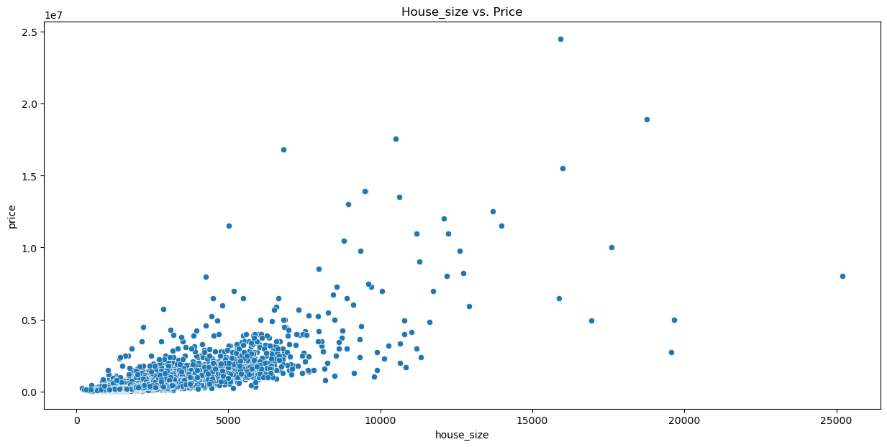
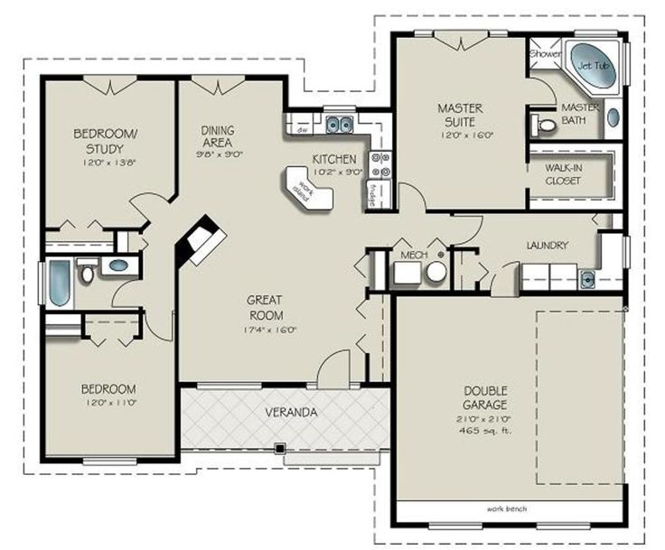
Data Visualization House Size and Price
Correlation - Positive correlation between house size and price however not perfectly linear spreading out after 5000sqft
Outliers - Larger houses such as possible luxury homes that may justify their high prices
X-axis (house size sqft) Most data between 0 - 10,000sqft
Y-axis (price $) from $0-$25M majority of data points below $10 million

Slide 6


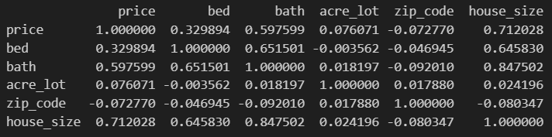
Data Visualization Correlation to Price, Bath, etc.
Price:
House Size .712 - Strong correlation as house size increases price tends to increase
Bath .598 - Middle of road positive correlation more bathrooms are associated with higher prices
Bed .330- Weaker positive
Acre Lot - Very weak positive correlation showing the little influence on price
Bath:
House size .848 Strong correlation showing more bathrooms are typically found in larger homes
Bed .652 strong correlation meaning homes with more bedrooms often have more bathrooms
Acre Lot - No correlation bathrooms are unrelated to lot size

Slide 7
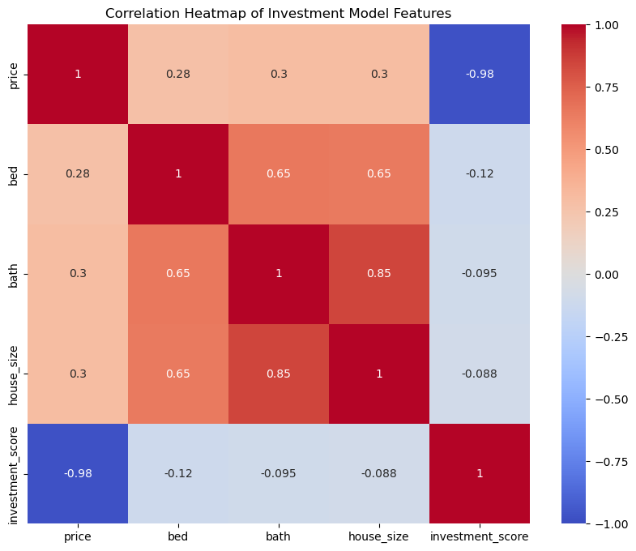
Investment Model Features Correlation Analysis
This correlation heatmap visualizes relationships between key real estate investment features:
Strong positive correlation (0.71) between price and house size
High positive correlation (0.85) between house size and bathrooms
Moderate correlation (0.65) between bedrooms and bathrooms
Investment score shows weak positive correlations with all features
Colors: Red = positive correlation, Blue = negative correlation (not present)
Intensity indicates correlation strength
The heatmap reveals how different property characteristics interact, with size-related features showing the strongest correlations.

Slide 8
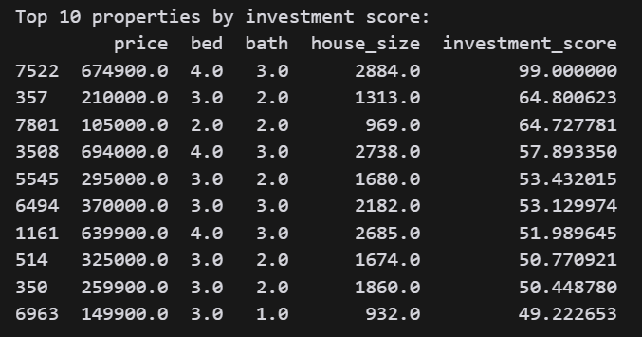
Top 10 Homes Based on Weighted Features
Key Points:
Displays top 10 properties ranked by investment score
Features considered: price, bedrooms, bathrooms, house size
Investment scores range from 49.22 to 99.00
Wide variety in property characteristics and prices
Top-scoring property doesn't necessarily have the highest price or largest size

Slide 9
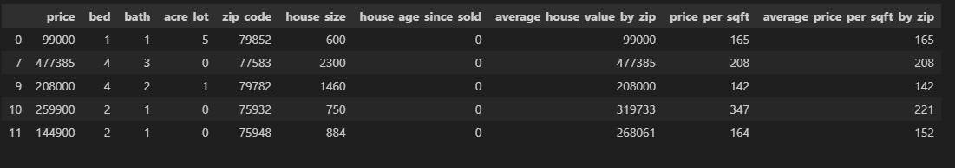
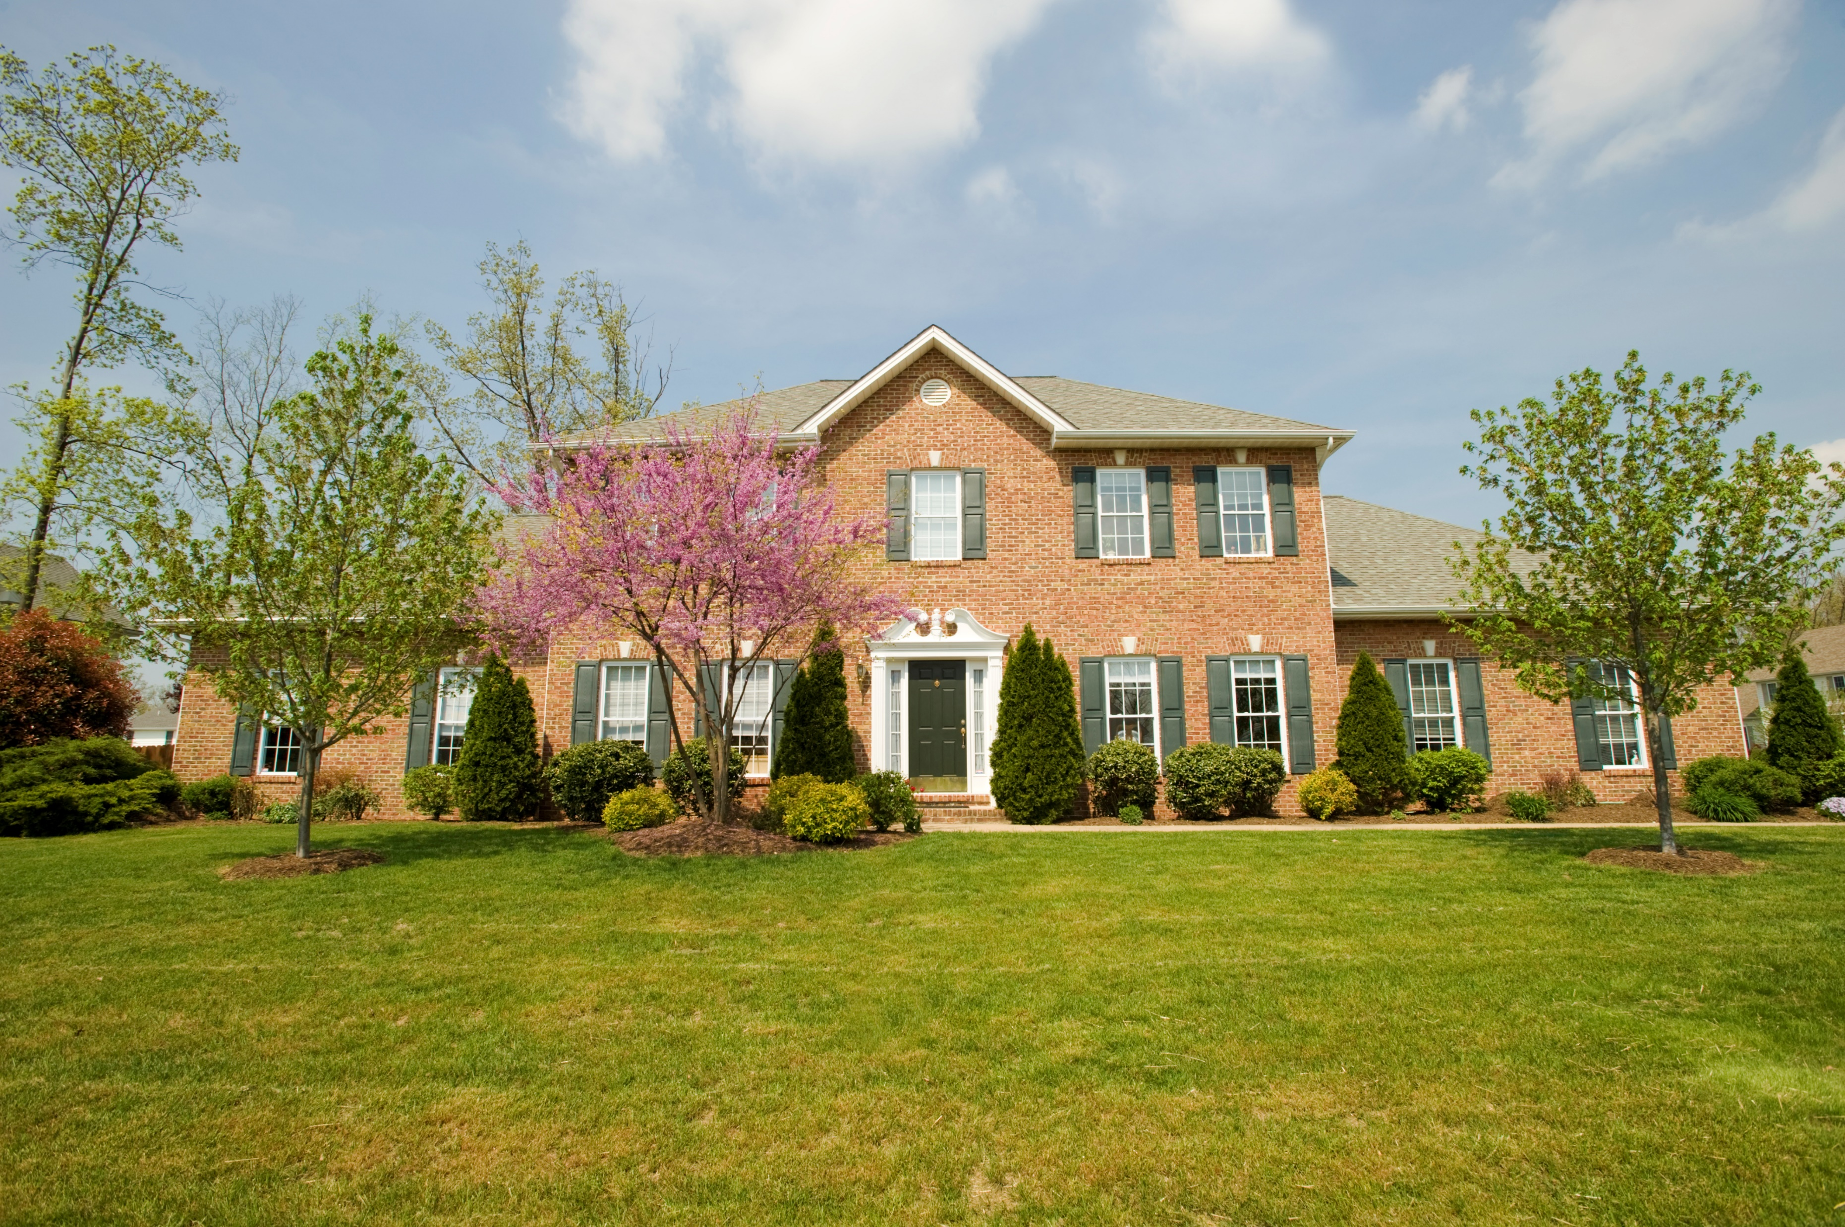
CatboostRegression Model Development
Data Transformation
Feature Engineering:
1. Create a new features that could capture important relationships:
We calculate the age of the house since it was last sold
Calculate average house value by zip code and round to integer
Calculate average price per square foot and round to integer
Calculate average price per square foot by zip code and round to integer
Create a new column 'zip_code_prefix' for the first three characters of 'zip_code'
2. Removed and convert rows and datas
Remove rows where 'house_size' or 'price' is zero or NaN
Remove the specified columns from the DataFrame
Convert 'bed' and 'bath' to string, replacing NaN with '0'
Convert 'price' and 'house_size' to integers
Replace 'acre_lot' and 'house_age_since_sold' NaN with '0'
Convert 'zip_code' to string, replacing NaN with '00000'

Slide 10
Model Development
In this project, I developed a machine learning model using CatBoost Regressor. After loading and exploring the dataset, I cleaned the data by handling missing values and outliers, then performed data transformation and encoding to prepare the features. The dataset was split into 80% training and 20% testing to evaluate the model's performance. I trained the model using the training set, optimizing hyperparameters like iterations and learning rate, and made predictions on the test set. The model achieved an R-squared of 0.64, indicating a decent level of accuracy in predicting real estate prices.
Performance Metrics
Mean Absolute Error (MAE): 131489.37
Mean Squared Error (MSE):235536872546.40
R-squared (R²): 0.6432
The model's performance metrics indicate that, on average, the predictions are off by 131,489 units (MAE), which is a significant error given the context of the data. The Mean Squared Error (MSE) is very high at 235.5 billion, suggesting that the model makes some large prediction errors, as MSE penalizes larger errors more heavily. The R-squared (R²) value of 0.6432 means that the model explains about 64% of the variability in the target variable, which indicates a moderate level of accuracy but also shows room for improvement.

Slide 11
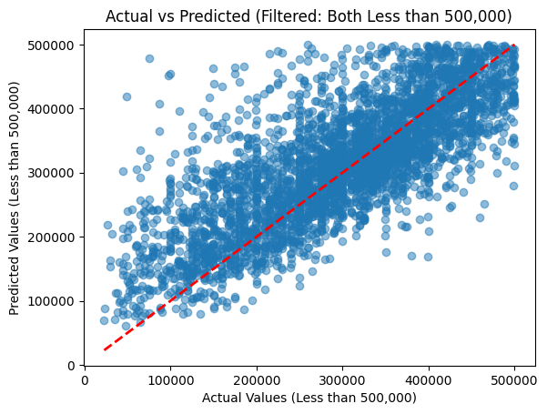
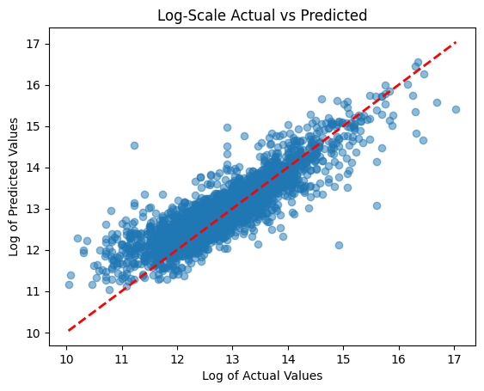
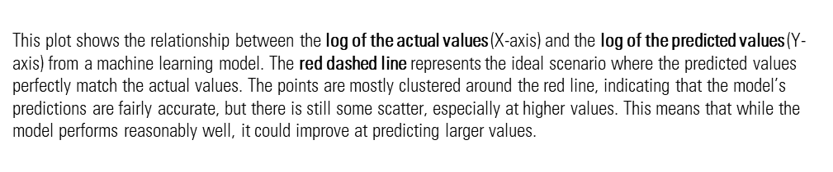
This scatter plot compares the actual and predicted values from the model, filtered to include only data points where both are less than 500,000. The red dashed line represents perfect predictions where actual equals predicted. Most points are close to this line, indicating that the model performs reasonably well in this range, though there is some spread, particularly for higher values, suggesting slight prediction errors as the actual values increase. Overall, the model is fairly accurate for predicting values under 500,000 but shows increasing variability at the higher end.

Slide 12
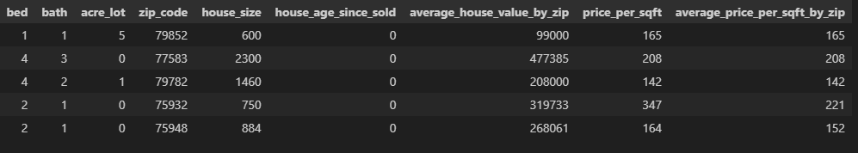
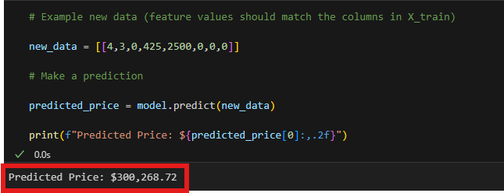
Input new data to predict the price using the trained Model

Slide 13
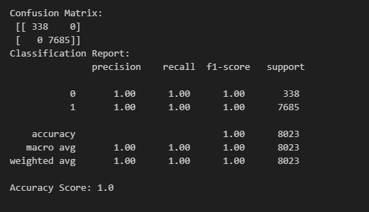
Decision Tree Classifier
Data Processing
Log Transformation Features and Sale Price: In a project where you're working with a Decision Tree Model for predicting Sale Price (common in real estate or regression tasks), one of the crucial preprocessing steps is log transformation of the target variable (Sale Price). Log transformation is especially useful when the target variable has a skewed distribution. After transforming the target variable, you’ll want to focus on the preprocessing of features for the Decision Tree Model, Feature Selection: House size (square footage), Number of bedrooms/bathrooms, Location (zip code, neighborhood), This preprocessing step (log transformation) helps the model better understand the data, yielding more accurate predictions and a more robust model. preprocessing step is essential for improving model performance, and when combined with proper feature engineering and handling of missing data, it results in a more robust model capable of producing accurate predictions on unseen data.
DecisionTreeClassifier
Brief description Decision Tree is a supervised learning algorithm that is used classification and regression modeling. Regression is a method used for predictive modeling. The model shows perfect performance on your test data, predicting every instance correctly. While perfect classification is possible, it often points to overfitting, especially when using an unrestricted decision tree. There’s a high likelihood that the model may not perform as well on unseen or new data. This makes it a good tool for understanding which features (e.g., number of bedrooms, square footage, location) are the most important in determining housing prices. The Decision Tree Classifier in this case achieved perfect classification across all metrics, meaning it made no errors in predicting whether an instance belonged to class 0 ("not for sale") or class 1 ("for sale").

Slide 14
Next Steps: To ensure the model's robustness, cross-validation and techniques like tree pruning should be employed to improve generalization and avoid overfitting.
The results show that the Decision Tree Classifier achieved perfect classification across all metrics, with no errors made in predicting either class. Specifically:The model correctly identified all 338 instances of class 0 ("not for sale").The model also correctly identified all 7685 instances of class 1 ("for sale").The model achieved an accuracy of 1.00 (100%), meaning all 8023 instances in the test set were classified correctly. This is the highest possible score for accuracy and confirms the performance seen in the confusion matrix and classification report. Achieving a perfect classification across all metrics means that the model flawlessly separated class 0 and class 1, with no errors in prediction. While this is an ideal result, it’s important to ensure that the model generalizes well to unseen data and doesn’t overfit the training data. In real-world scenarios, achieving such perfection is rare and might require further analysis of the dataset to ensure that the model isn’t overfitting or being evaluated on an unusually easy subset of data.

Slide 15
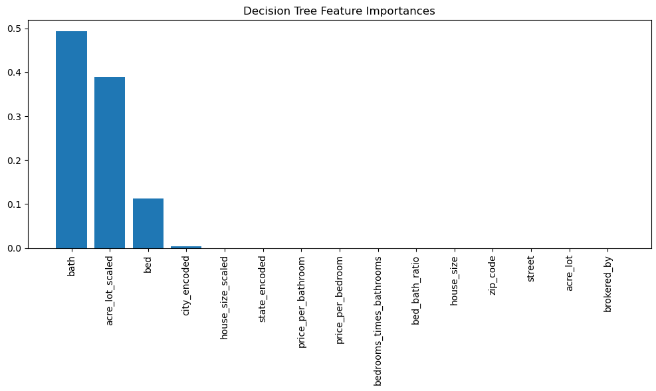
The number of bathrooms and lot size (acre_lot_scaled) are the dominant factors driving the predictions of the model. Other features, including the number of bedrooms, have less influence, but still contribute to the decision-making process. The most important feature in predicting the target variable, with an importance value close to 0.5. This suggests that the number of bathrooms in a property is the most influential factor in determining housing prices.

Slide 16
Personal insights
These models helped emphasize how much feature engineering improved model scoring. I saw the biggest change in Cat Boost Regression model when effectively engineering features as opposed to features and pricing models. Which is designed to handle categorical data efficiently, thoughtful feature engineering can significantly boost performance. By understanding the relationships between variables and creating meaningful features, you're able to unlock more predictive power from the data, which leads to the substantial improvements.
Pain Points
Not enough data -the dataset not enough data points to run model; Preprocessing of data receiving errors; Features that were not very relevant to what we were trying to predict providing the need for further scaling and preprocessing
Overfitting - causing the accurate scoring of model. Also, when a model becomes too tailored to the specific patterns or noise in the training data, performing well on the test set but failing to generalize to new, unseen data.
Imbalanced Dataset - In cases where one class (e.g., class 1, "for sale") is significantly more prevalent than the other (class 0, "not for sale"), achieving a perfect classification might indicate that the model is overly focused on the majority class. The model may simply be predicting the majority class rather than genuinely learning the distinction between classes.
Future Work
Future models could involve exploring additional feature engineering techniques, importing external features, and testing more complex models to further enhance performance and scoring. By extracting and creating new features, you can help your model capture more nuanced relationships between the data and the target variable. Some advanced techniques include Creating interaction features allows the model to capture relationships between multiple variables. For Example, Date/Time Features Year/Month of Sale, Time Since Renovation, Age of Property. Or Economic Indicators Interest Rates and Zip Codes. Geospatial Data Proximity to amenities: Schools, parks, hospitals, etc. Crime Rates: Adding data on crime rates in specific neighborhoods can enhance the model’s predictive power. Public Transportation: Including features related to the distance to public transport stations or highways.

Slide 17
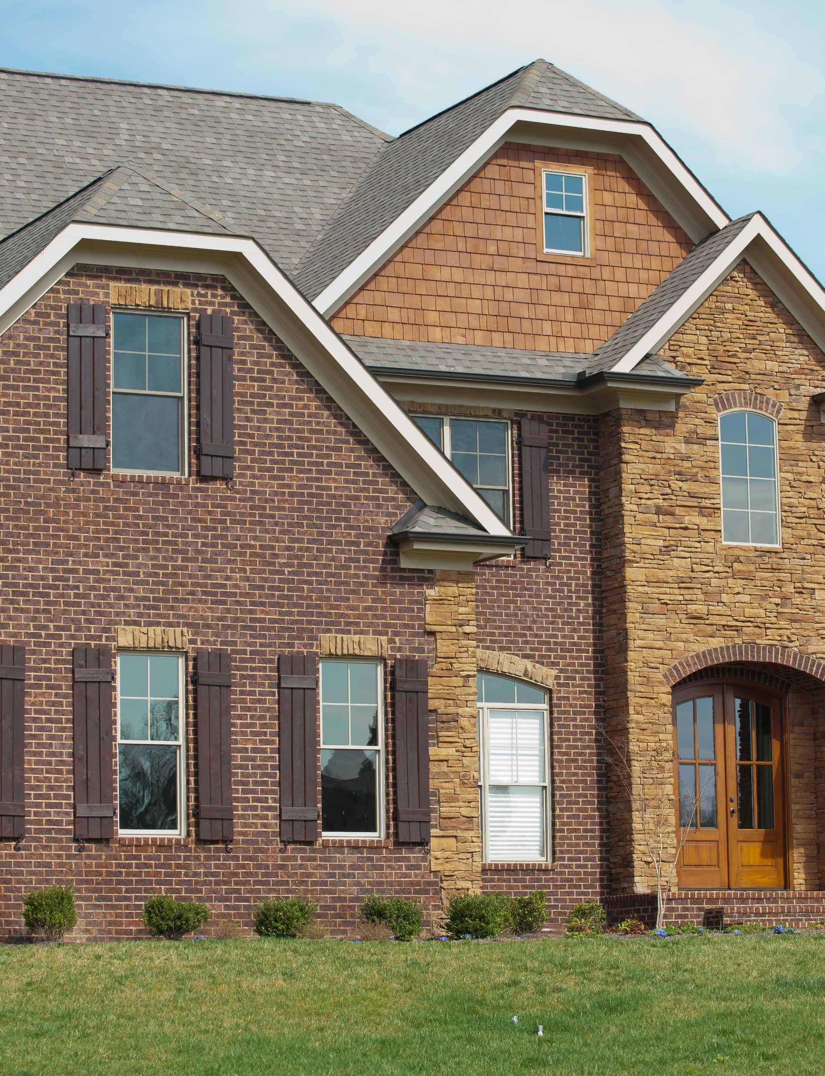
THANK YOU
Links:
Dataset: Housing Market & Prices (kaggle.com)
Github Link: https://github.com/MichaelSheveland/Project-2-Group-3.git

